Slide 1

MASS MAIL DISPATCHER

Slide 2
ABOUT MASS MAIL
Mass Mail means a large number of email messages with similar content sent or received in a single operation or a series of related operations.
A mass mail is a marketing message sent by a brand to multiple recipients at once. It aims to promote a business, sell goods, and develop relationships.

Slide 3
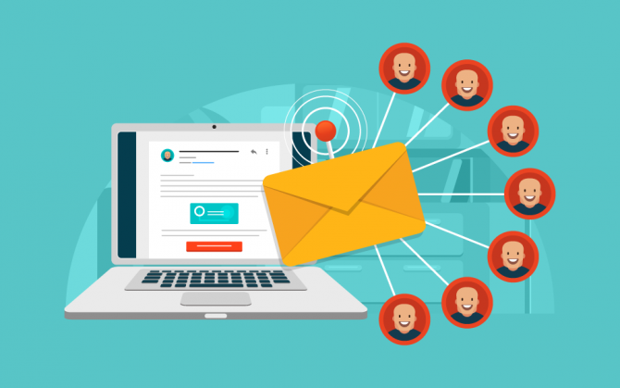
OBJECTIVE:
A Mass-Mail Dispacther is a system in which a sender can send message to many receiver at a time.For this purpose sender has to upload .CSV file .
The website filters out the valid mails and invalid mails from uploded .CSV files. After verification the mails are listed out and email is created and send to valid mail

Slide 4
ABSTRACT :
This Project report consists of basic idea of Mass-Mail Dispatcher sending through personal computer.The system has been working with in this project is the web-based Mass-Mail Dispatcher. The application is designed to send mass mails to all the recipients uploaded through a CSV file. The purpose of this is to provide a tool to control and send emails to a vast number of recipients. The application will list and sort out all the valid and invalid emails detected by the application allowing the users to more readily send emails as per user convenience. The end user should be able to upload CSV file. The application shall list the detected invalid emails found in the CSV File. The user should be given a structured list of the valid emails.

Slide 5
EXISTING SYSTEM:
Mail is information stored on a computer that is exchanged between two users over telecommunications. More plainly, e-mail is a message that may contain text, files, images, or other attachments sent through a network to a specified individual or group of individuals.
One to one mail are essentially personal emails that are sent from you to your subscribers. One to one email marketing can be a really useful channel for small ecommerce businesses to capitalize on a more personal relationship with customers, by focusing on quality over quantity. But when it comes to sending mails to a large number of contacts then this methodology doesn’t work.

Slide 6
PROPOSED SYSTEM:
The system has been working with in this project is the web-based Mass-Mail Dispatcher. The application is designed to send mass mails to all the recipients uploaded through a CSV file. The purpose of this is to provide a tool to control and send emails to a vast number of recipients. The application will list and sort out all the valid and invalid emails detected by the application allowing the users to more readily send emails as per user convenience. The end user should be able to upload CSV file. The application shall list the detected invalid emails found in the CSV File. The user should be given a structured list of the valid emails.

Slide 7
ADVANTAGES:
Cheaper cost
Reduced Time and Efforts
Reach a larger number of customers
Targets Suitable Audience
Personalize message
Frequent communications

Slide 8
CONCLUSION:
Mass-Mail marketing is one of the leading techniques that most of the organizations and digital marketers use to compete with today's highly competitive business world. Mass email software helps you deliver your personalized messages to a filtered audience. Moreover, it effectively reduces both your time and efforts. Most importantly, it allows you to track your campaigns in terms and engagement and sales.
By using the method of mass-mail dispatcher we get a lot of benefits. Benefits like cheaper cost, reach a large number of customers, reach the right i.e., valid customers, generating high quality leads, effectiveness of mails, real-time mails.

Slide 9
THANK YOU

